Slide 1
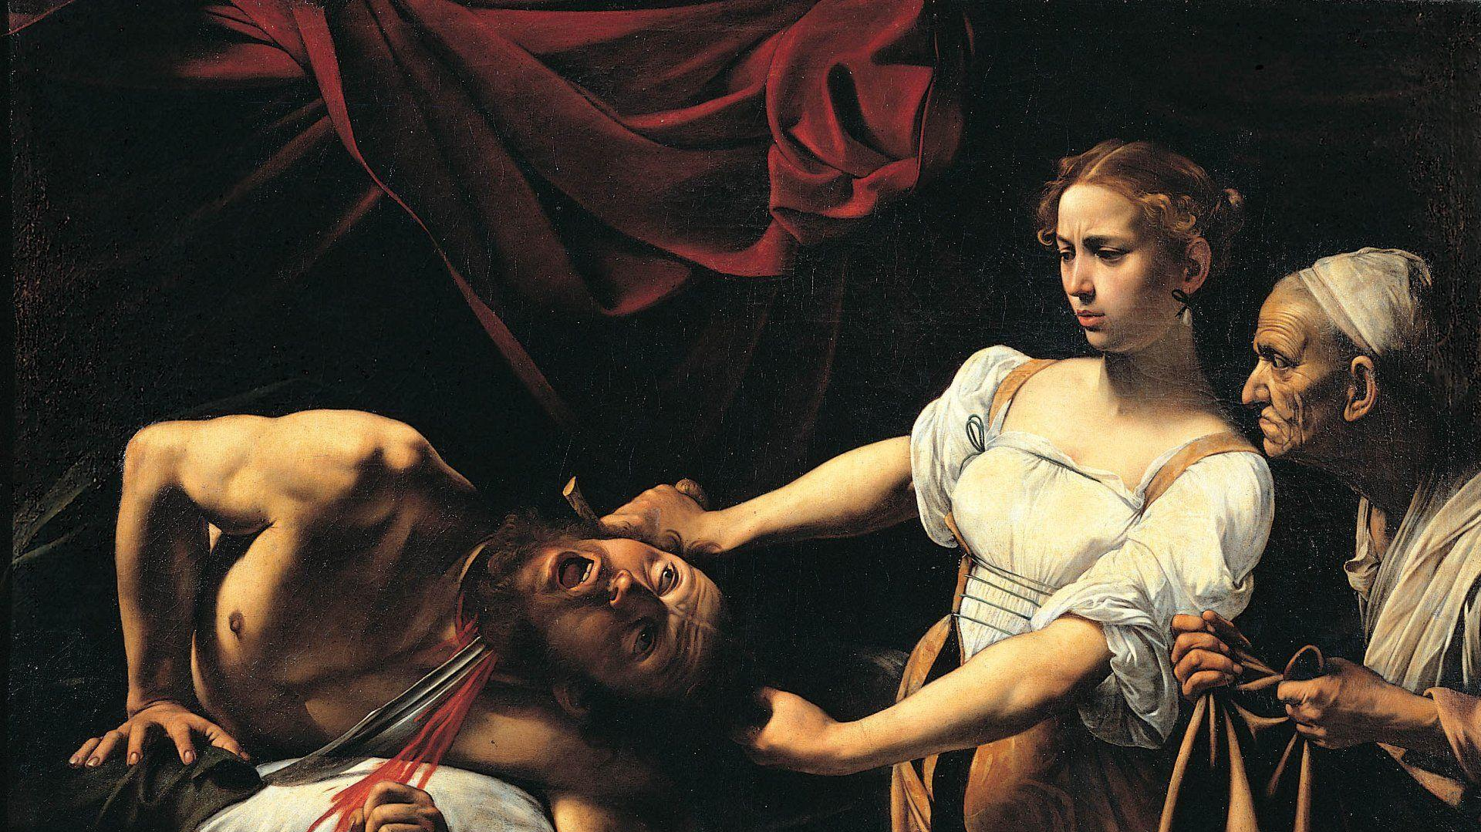
Arbitrary Style Transfer Computer vision project
D’ORAZIO ANTONIO
MINUT ROBERT ADRIAN
zarba meli GIACOMO

Slide 2
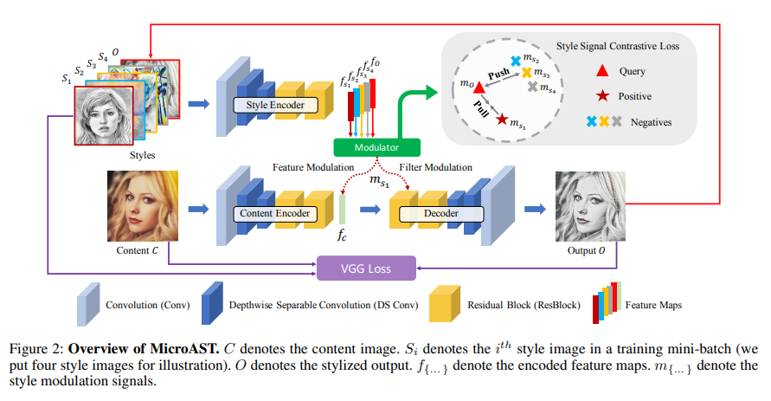
Reference Paper
MicroAST

Slide 3
Overview
Code refactoring with newer libraries
PyTorch Lightning, Torchmetrics, Weight and Biases
Different experiments to improve the performance from the baseline code
Architecture
Loss functions
Fine tuning of the model for two different tasks
Generic
Faces
Demo app for testing the model

Slide 4
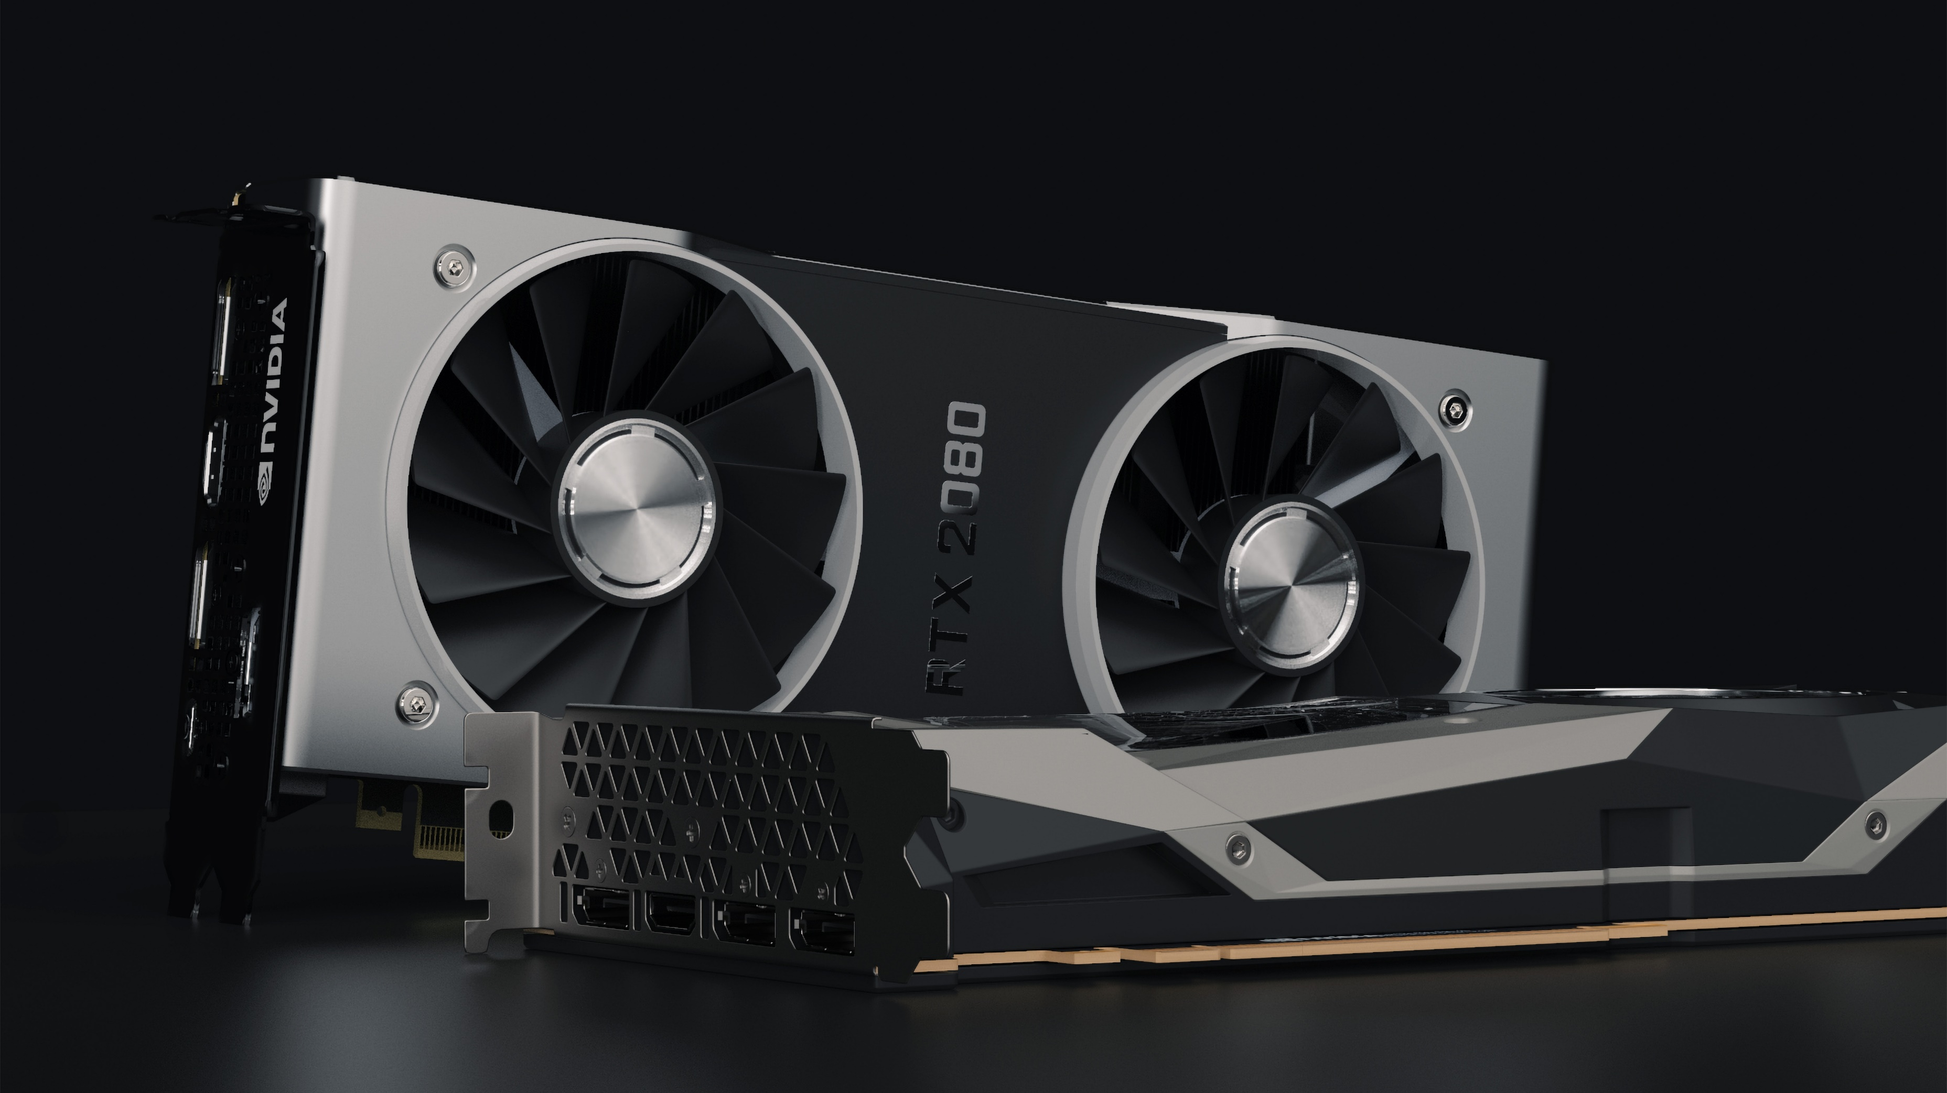
The model

Slide 5
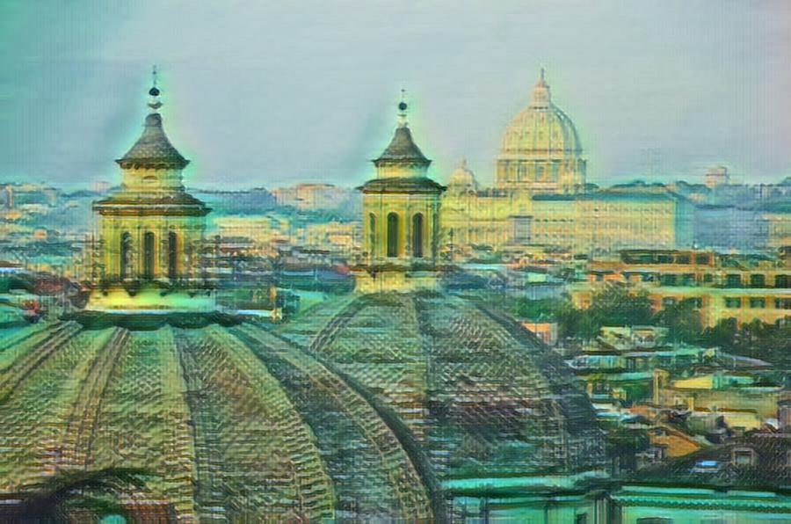
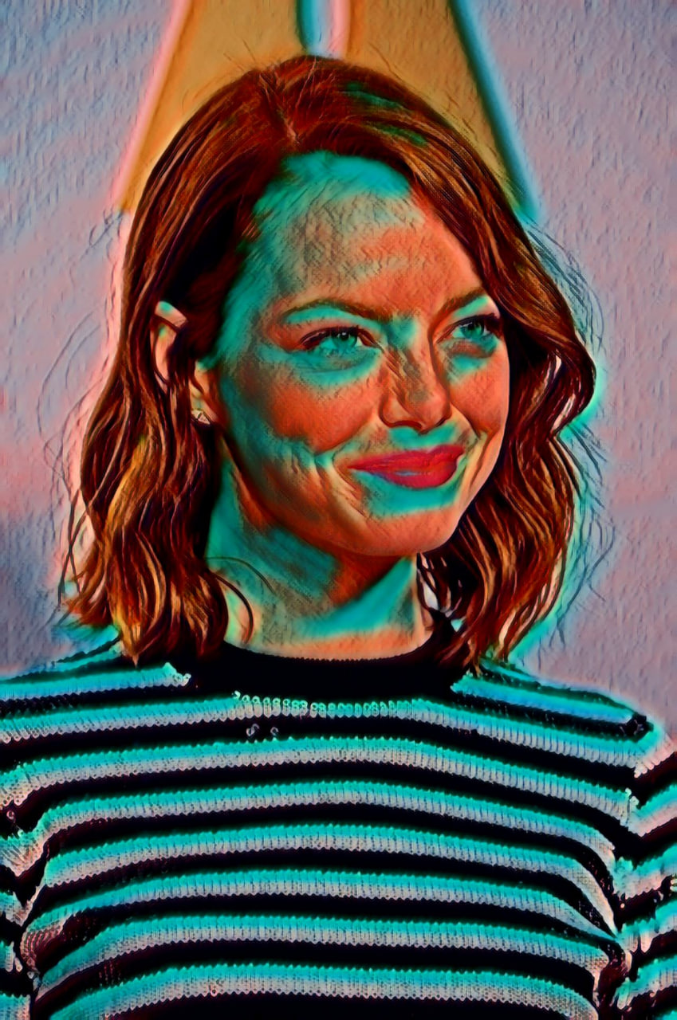
Challenges
The final images suffer from artifacts caused by the inverse convolution
The style isn’t always applied in a smooth way
It’s not well suited for faces

Slide 6
Datasets
We first tried using different datasets
Style
WikiArt (default)
LAION-Aesthetics
Content
COCO 2017 (generic)
Flickr-Faces-HQ (faces)

Slide 7
Tests on the architecture
TODO

Slide 8
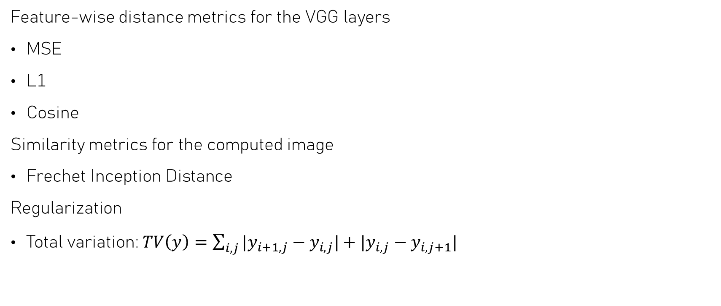
Loss functions and distance metrics
Feature-wise distance metrics for the VGG layers
MSE
L1
Cosine
Similarity metrics for the computed image
Frechet Inception Distance
Regularization
Total variation: $TV\left(y\right)=\sum_{i,j}{|y_{i+1,j}}−y_{i,j}|+|y_{i,j}−y_{i,j+1}|$

Slide 9
Hyperparameters tuning

Slide 10
Plots

Slide 11

The web app

Slide 12




Architecture of the app
Frontend
Backend
call
test_microAST.py
Run inference
Save image on disk

Slide 13
Demo

Slide 14
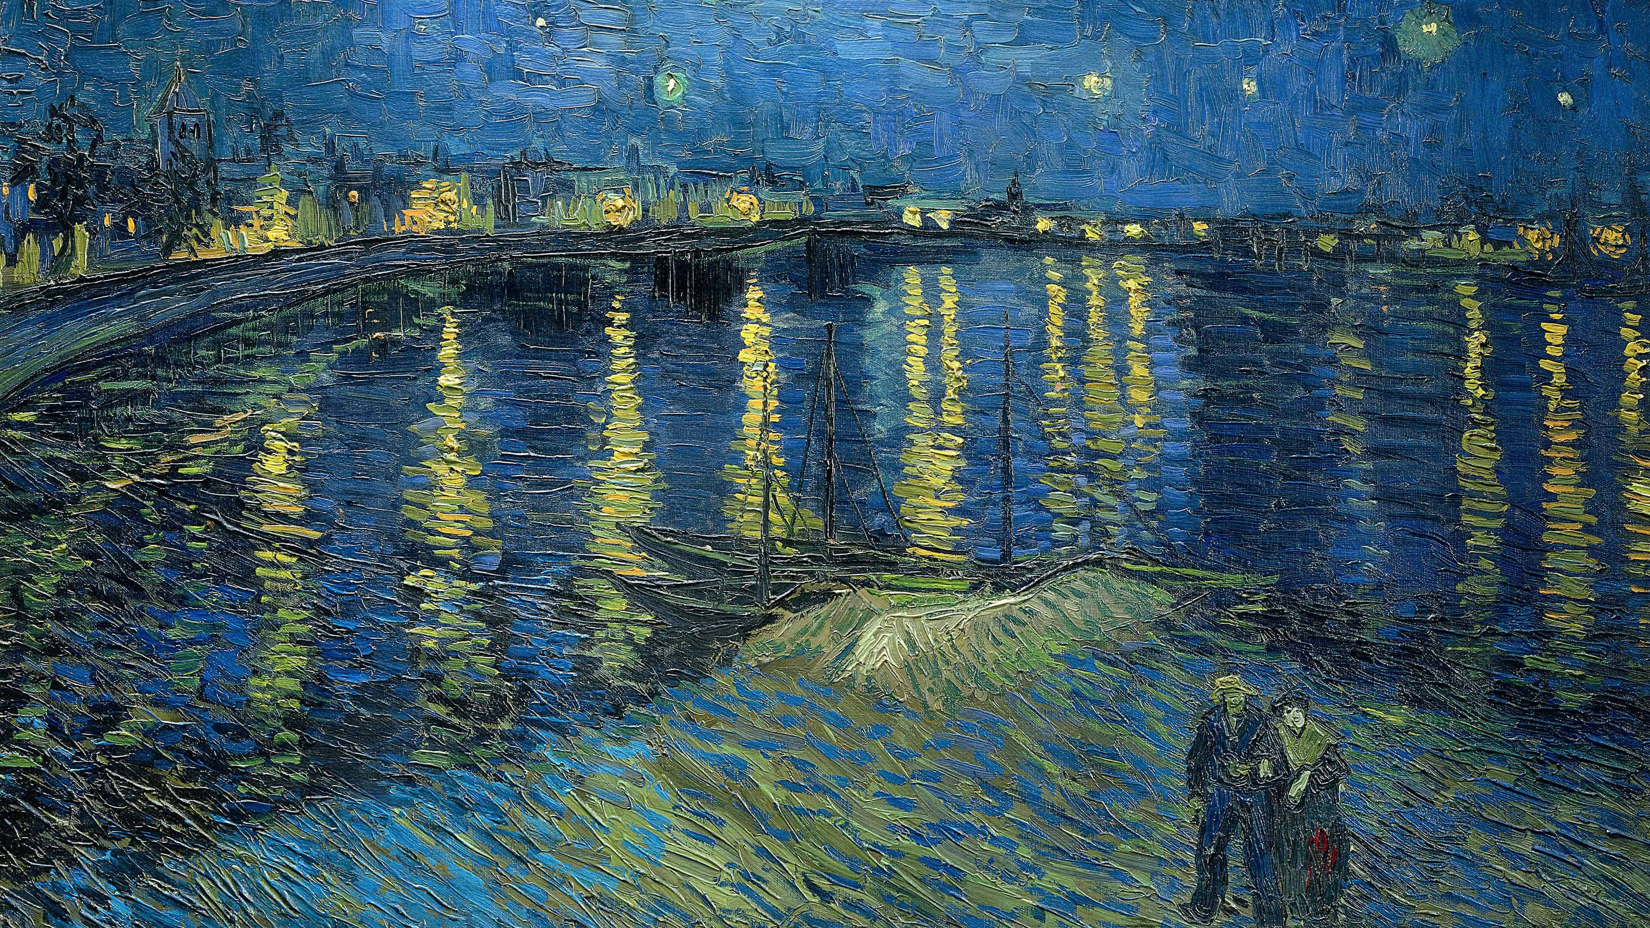
Final results

Slide 15
Generic

Slide 16
Faces

Slide 17
References
MicroAST: Towards Super-Fast Ultra-Resolution Arbitrary Style Transfer
How to get beautiful results with neural style transfer
Winning at loss functions: 2 important loss functions in computer vision
Experiments on different loss configurations for style transfer
Deep image quality assessment
The Unreasonable Effectiveness of Deep Features as a Perceptual Metric (arxiv.org)

